Slide 1
How to use this template
Make a copy to your Google Drive
Read speaker’s notes — there’s some guidance there
Edit to your liking
Use in your presentation or print out
Remember to discard this first page
Any questions? Give Wojtek Kutyla a shout on Slack.

Slide 2
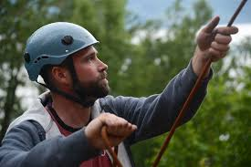
Your proto-persona’s name
Behaviours
William Burns
Super keen Winter Climber
Climbs most weekends
Meets the other Edinburgh Uni Mountaineering Club members on a Thursday evening to drink beer and plan weekend trips.
Spends time pouring through guidebooks and noting routes he would like to climb.
Trains lots for climbing.
Works herd on his degree too and doesn’t have much flex in his week.
Demographic information
Needs and goals
Final year Geology Student
Single and very climbing focussed
Not very well off, but has enough cash to climb in Scotland most weekends
Pretty tech savvy. Has access to laptop in his shared flat and has an iPhone4s.
Lives in Edinburgh
Wants to climb hard Winter routes when they are in good condition.
Likes being the one who suggests the best option for weekend climbing over a beer on Thursday.
Wants a quick way of reviewing his climbing options based on the conditions, preferably over a beer on a Thursday evening.
Notes:
When naming your proto-persona, keep it real. The goal is to empathise with them, and if their name is Bilbo Baggins it’s rather hard.
Remember to download only non-watermarked, free-to-use photographs. Use Creative Commons search in Google or Flickr to find such photos. Make these appear and feel 'real'.
When establishing basic characteristics, keep it short and simple. Who are they?
Demographic information should be relevant to the project. Think of all aspects that might affect how people interact with your product. Think of the following first:
Where do they work/what they do?
What’s their relationship status? Do they have children?
How much do they earn — and is this relevant?
What’s their level of familiarity with digital technologies?
Add your own.
Behaviours are simply things that they do. Keep it relevant to the project.
Needs and goals — this is what they want from the product and your organisation.

Slide 3
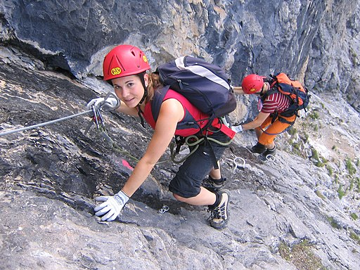
Your proto-persona’s name
Behaviours
Jennifer Williams
Professional who uses Guides to maximise mountaineering access
Limited on time during the week due to work commitments.
Likes to go climbing at weekends, but limited as her partner isn’t a climber. Generally only available to get out once a month.
Not having much time to climb, she likes to limit herself to routes she is comfortable climbing.
Tends to climb with a guide, in Summer and Winter
Likes to choose her own routes, or at least suggest suitable routes to her guide.
Demographic information
Needs and goals
Criminal Defence Lawyer
In a relationship with a non-climber
Plenty disposable income
Super tech savvy, all the gadgets
Efficient search of for routes of suitable technical difficulty.
Doesn’t get out much, so is looking for top quality routes when she does.
Likes a good long route.
Notes:
When naming your proto-persona, keep it real. The goal is to empathise with them, and if their name is Bilbo Baggins it’s rather hard.
Remember to download only non-watermarked, free-to-use photographs. Use Creative Commons search in Google or Flickr to find such photos. Make these appear and feel 'real'.
When establishing basic characteristics, keep it short and simple. Who are they?
Demographic information should be relevant to the project. Think of all aspects that might affect how people interact with your product. Think of the following first:
Where do they work/what they do?
What’s their relationship status? Do they have children?
How much do they earn — and is this relevant?
What’s their level of familiarity with digital technologies?
Add your own.
Behaviours are simply things that they do. Keep it relevant to the project.
Needs and goals — this is what they want from the product and your organisation.

Slide 4
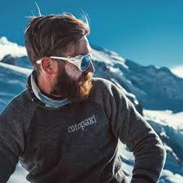
Your proto-persona’s name
Behaviours
Mark Radford
Family orientated recreational climber who likes good aesthetic Winter lines
Gets out climbing locally with his Wife and other pals most weeks.
Climbs a couple of weekends a month.
Gets out a few times a Winter with his Sons.
Doesn’t like climbing Summer routes in Winter, preferring Winter only lines.
Demographic information
Needs and goals
Semi-retired teacher
Married with 2 grown up Sons
Wife also climbs (annoyingly well for his taste)
Both Sons also climb better than him, but he still likes to get out.
Comfortable financial situation, but nothing flash
Happy with computers, but not keen on smart phones. Has laptop in the house and access to work computers most days.
Wants to come up with good suggestions for Winter routes before his sons (or his Wife!), at the right standard for the team
Wants to find good Winter only lines to climb
Is quite keen to finish his list of cold climbs ticks, but only in suitable conditions
Notes:
When naming your proto-persona, keep it real. The goal is to empathise with them, and if their name is Bilbo Baggins it’s rather hard.
Remember to download only non-watermarked, free-to-use photographs. Use Creative Commons search in Google or Flickr to find such photos. Make these appear and feel 'real'.
When establishing basic characteristics, keep it short and simple. Who are they?
Demographic information should be relevant to the project. Think of all aspects that might affect how people interact with your product. Think of the following first:
Where do they work/what they do?
What’s their relationship status? Do they have children?
How much do they earn — and is this relevant?
What’s their level of familiarity with digital technologies?
Add your own.
Behaviours are simply things that they do. Keep it relevant to the project.
Needs and goals — this is what they want from the product and your organisation.

